Slide 1
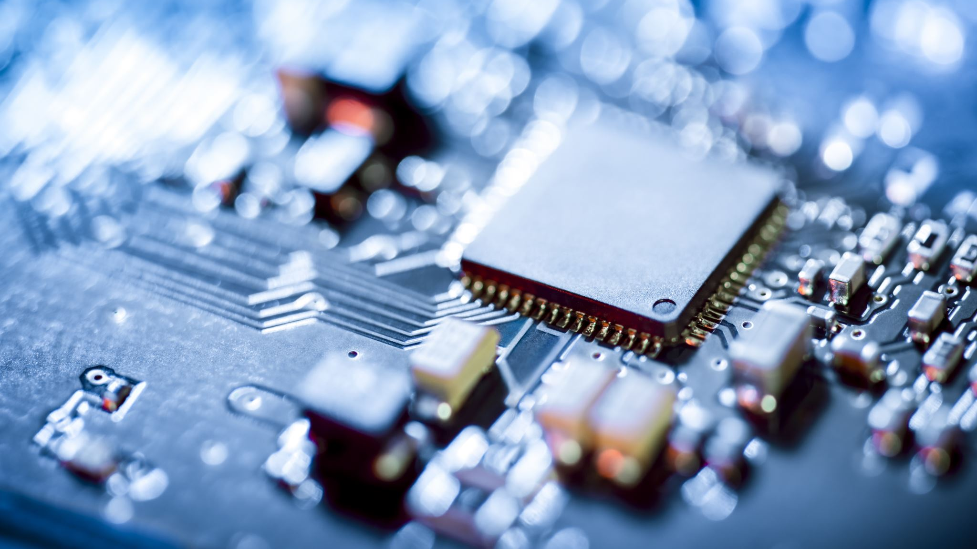
Electric Field of a Parallel Capacitor
Thevexis

Slide 2


Solving Partial Differential Equations

Slide 3
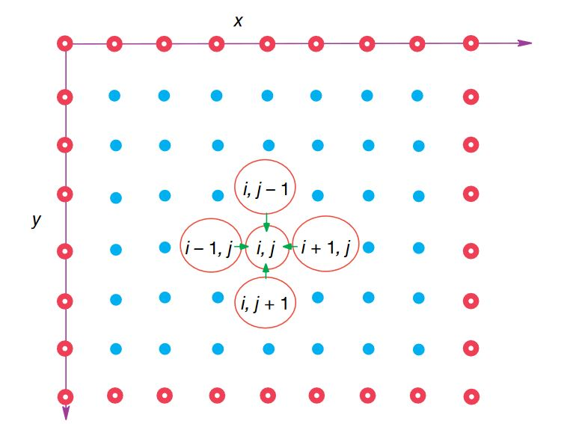
Finite Difference

